Slide 1
FRC Meeting 1-20

Slide 2
Innovation Challenge
Focus:
Physical Health
Mental Health
Both
Ideas:
Heart Disease
Obesity
COVID
Depression
Veteran Medical/Social Media thing -- This one

Slide 3
Game Design Theme Ideas
Must Have 5th Element
Chemistry Focus
Could have different elements to create new molecules (i.e. Hydrogen and Oxygen elements to make H20
Different molecules could be worth different points
Could have power ups called “Catalysts”
Human Player : Robot Delivers base pairs (ball) to Human Player (maybe via shooting) human player builds DNA
New element : AUTO, extra base pairs from pulling chain to release
Human Body game : chain pulled to release blood clots. Main element, red blood cells, bots deliver to human player
Ascension : Rungs of DNA used to pull up.
Fusion
Quantum Mechanics
Better Recycle Rush -- Different weight boxes

Slide 4
Game Design Overview
Need:
15 sec Autonomous Period
Have bonuses for scoring
Preload Elements
2 min 15 sec Teleop Period
30 sec Endgame
Lift System
Elements:
One main element with multiple ways to score it
Initiation Lines
Get bonus points for crossing line
Human Players
Ranking Points
Penalties

Slide 5
Robot Renovations
Intake
Intake is pretty good
Ideas for more efficiency:
Rollers in a more arc position than Linear One
Would prevent less losses of ball
Gas Springs for Extension of Intake
Optional: Different Material for Less weight
Better Intake catch -- Pool Noodles
Shooter
Make better

Slide 6
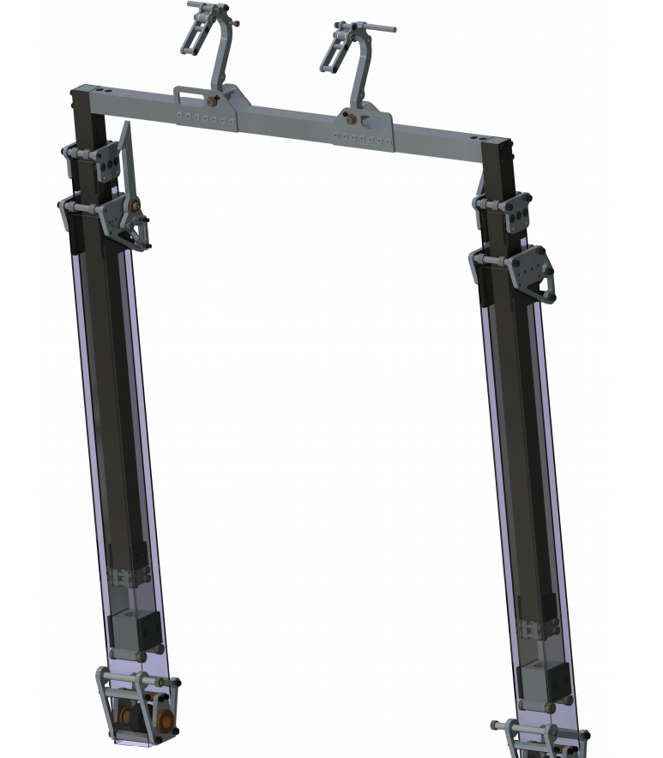
Lift System Renovation
2 Stage Telescopic Lift
CIM Motor
Use Constant Force Spring for fast extension of 1st stage
Ratcheting System for 2nd
Bearings Inside for smooth transitions

